Slide 1
Horton’s Launchpad
SC4053 BLOCKCHAIN TECHNOLOGY · OPTION 2: DUTCH AUCTION
Anyone can launch a token. Every token sells in a fair, 20-minute Dutch auction where everyone pays the same price.
Syed Ridwan · Yojin Oh
Demo video · local Hardhat chain · MetaMask
Notes:
SYED: Hi, we’re Syed and YJ. This is Horton’s Launchpad, our project for SC4053 Option 2. Anyone can launch an ERC20 token from our website, and every token sells in its own fair, 20-minute Dutch auction.

Slide 2



Fixed-price token sales reward speed, not value
THE PROBLEM
Gas wars
A guessed price
Bots
Everyone rushes at once, so whoever pays the most gas gets in.
The seller picks a number. Tokens end up overvalued or undervalued.
Front-running bots drain the pool before people can bid.
Our answer: the price starts high and falls until the market says yes.
Notes:
SYED: Fixed-price token sales have three problems. Everyone rushes at once, so whoever pays the most gas wins. The price is the seller’s guess, so tokens end up over- or undervalued. And bots get there first. A Dutch auction turns this around: the price starts high and falls until the market says yes.

Slide 3
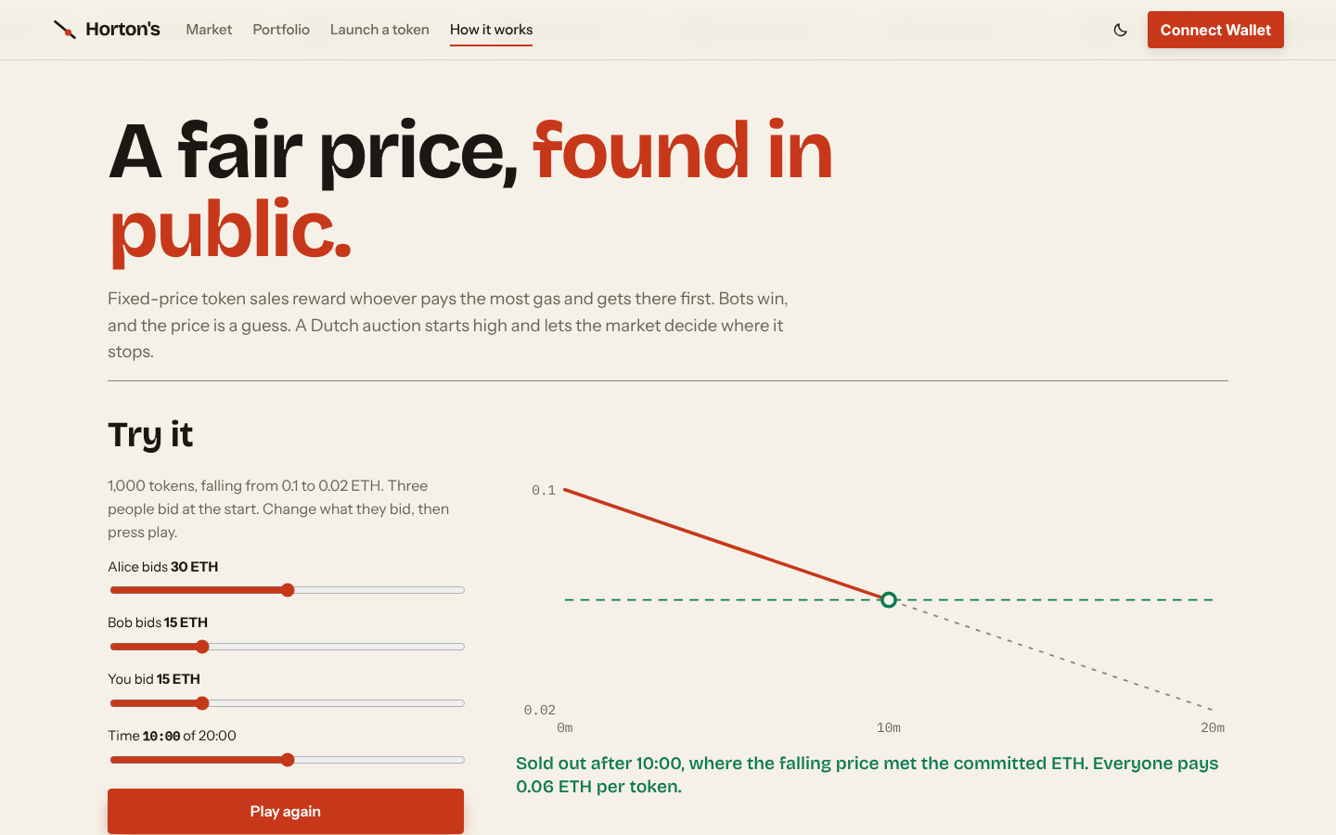
Everyone pays the price where the falling line meets the money
HOW THE AUCTION CLEARS
1
Bidders commit ETH while the price falls for 20 minutes.
2
It clears the moment the ETH committed can buy every token.
3
The bid that crosses the line is capped, and its surplus refunded at once.
4
If time runs out first, it settles at the reserve and unsold tokens are burned.
Our simulator: 60 ETH for 1,000 tokens clears at 0.06 ETH, for every bidder.
Notes:
SYED (switch to the site’s How it works page, sliders at 30, 15 and 15, press Play): Here’s the rule we built, straight from the brief. Bidders commit ETH while the price falls. The moment the ETH committed can buy every token, the auction clears. Here 60 ETH is committed for 1,000 tokens, so it clears at 0.06 ETH, and everyone pays 0.06, including whoever bid first. Your bid is a share of a pool, not a purchase at that moment’s price. If 20 minutes pass first, it settles at the reserve and the unsold tokens are burned.

Slide 4

One transaction creates a token and its auction
ARCHITECTURE
HortonsToken
React site
LaunchFactory
ERC20 + burnable, fixed supply
Reads the chain directly. No backend. The wallet is the login.
createLaunch: deploys, funds and starts one auction. Forwards the seller’s ETH.
DutchAuction
Holds the ETH. bid · finalize · claim · withdraw
Role | Who | Can
Bidder | Any wallet | Bid, settle, claim, and track coins live
Seller | Creator of a listing | Launch a token, and withdraw the ETH raised, once
Curator | One fixed address | Hide or verify listings. Never touch funds
Notes:
SYED: Under the hood there are three contracts. A seller calls LaunchFactory once. It creates a new HortonsToken and a new DutchAuction, moves the whole supply in and starts the clock, all in one transaction. Bidders then deal with that auction directly. The auction holds the money, and the price is computed from the block’s timestamp. The curator can only hide or verify a listing, never touch funds. There’s no backend: the site reads everything from the chain, and your wallet is your login.

Slide 5
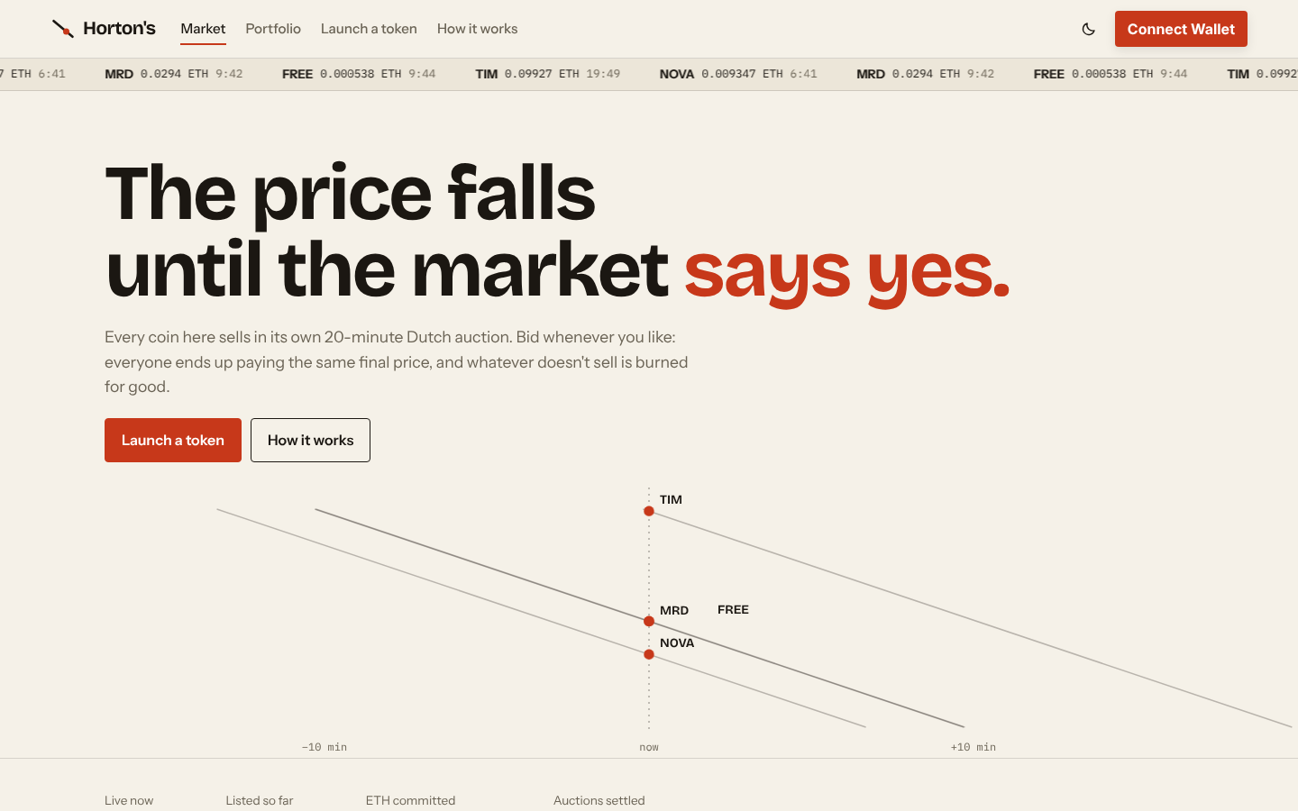
Six listings, one in every state
LIVE DEMO
Listing | What we show
Horton’s | A plain bid, and the contract’s live sums
Meridian | A bid that sells it out, with the surplus refunded
Your own | Launching a new token from the website
Aurora | The seller withdrawing the ETH raised
Free Money | The curator hiding a misleading listing
Nova | Expiry at 20 minutes, and unsold tokens burned
Local Hardhat chain · real MetaMask · three accounts: buyer, seller and curator
Notes:
SYED: Now the live demo. Everything runs on a local Hardhat chain, with real MetaMask and three accounts: a buyer, a seller and the curator. We’ve seeded six listings so you can see every state an auction can be in.

Slide 6
Drainable in our first version, blocked now
BONUS: REENTRANCY
V1, WRITTEN BY HAND
FINAL
8 ETH + 200
0 re-entries
An attacker re-entered once and took double its fair share of 4 ETH + 100 tokens.
State is written before any ETH moves, and bid, claim and withdraw are locked with nonReentrant.
Six attack tests: re-entry during the refund, the claim and a seller’s withdrawal.
Notes:
YJ: The brief’s bonus is reentrancy. Our first, hand-written version really was drainable: an attacker re-entered once and walked away with double its fair share. That’s how we know the attack works. Now state is written before any ETH moves, and every function that moves money is locked. Our attacker contracts try to re-enter during a refund, a claim and a seller’s withdrawal, and every attempt fails.

Slide 7
Tested at every layer
EVIDENCE
87
100%
23 / 23
contract tests passing
line coverage
planted bugs caught
17 / 17
39
0
end-to-end steps passing
frontend unit tests passing
high Slither findings
98% branch coverage · all of it runs in GitHub Actions on every push
Notes:
YJ: Here’s the evidence. 87 contract tests and 39 frontend tests pass, and an end-to-end test drives the real site through 17 steps. We have 100% line coverage, but coverage only shows the code ran. So we planted 23 bugs on purpose to check that the tests catch them. Three got through at first, so we wrote new tests until all 23 were caught. Slither finds nothing high-severity, and all of this runs in CI on every push.

Slide 8
We audited the AI like an untrusted contributor
THE AI AUDIT
AI-10 · wrong design
AI-1 · rounding
AI-28 · gas
166.67 vs 600
28 green tests
Out of gas
ETH paid to the seller on the same bids: an AI-built design underpaid by 72%.
All passed while the last bidder’s tokens could be stuck. A planted bug exposed it.
A sell-out bid could fail. The test wallet’s unlimited gas hid it.
28 AI mistakes logged, each with why it happened, why it matters, the fix and the evidence.
Notes:
YJ: We built with AI tools, mainly Claude Code, and audited them like an untrusted contributor. Passing tests weren’t enough. One AI-built design paid the seller 166 ETH instead of 600 on the same bids. A rounding bug that could strand the last bidder’s tokens got past 28 passing tests, and only a deliberately planted bug exposed it. And a bid that could run out of gas was hidden because our test wallet never runs out. We logged 28 AI mistakes, each with its cause, its impact, the fix and the evidence, in our AI Audit Report. Our biggest lesson: never let the tool that wrote the code be the only thing that checks it.

Slide 9

Every brief requirement, working on screen
ERC20 tokens, in a separate auction contract
Exactly 20 minutes, linear price decay
One uniform clearing price for everyone
Surplus ETH refunded automatically
Unsold tokens burned from total supply
Reentrancy resistance (bonus)
Thank you
Syed Ridwan · YJ · Horton’s Launchpad · SC4053
Notes:
SYED: That’s Horton’s Launchpad: every requirement in the brief, working on screen, with the evidence and the AI audit in our repository. Thank you for watching.

